Slide 1

Vectrosafe
Powered by BTPNS
Fuad Zauqi Nur
Final Project
2020
BTPNS Shifted Batch 2

Slide 2
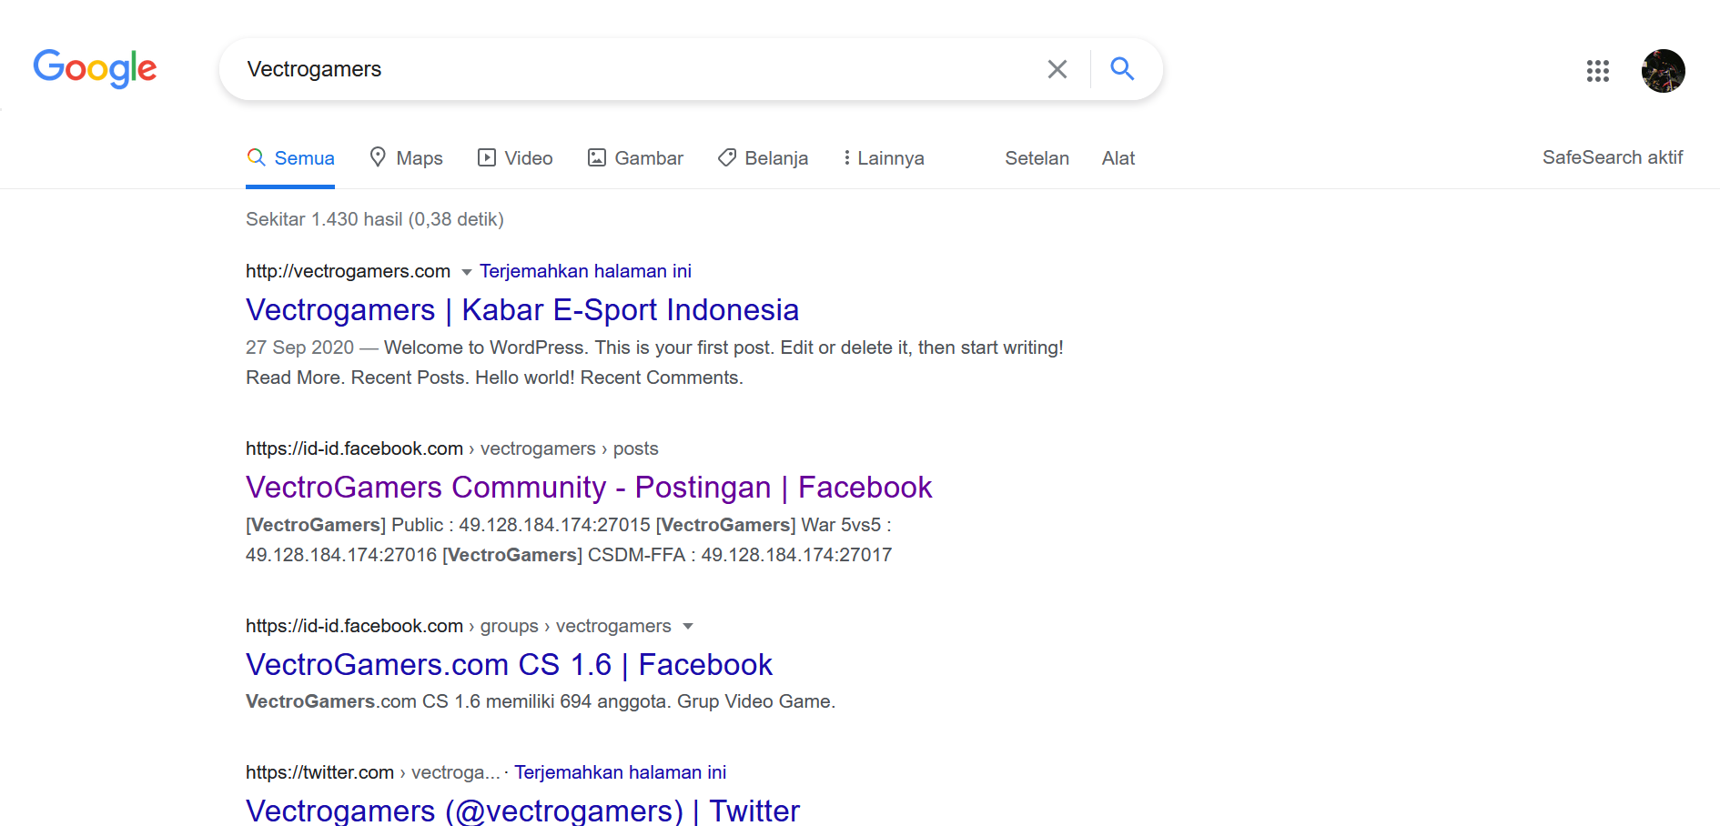

Vectrosafe?

Slide 3
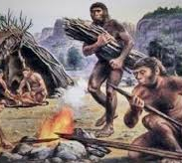



Tahap Pengembangan Aplikasi

Slide 4







Perencanaan
?

Slide 5
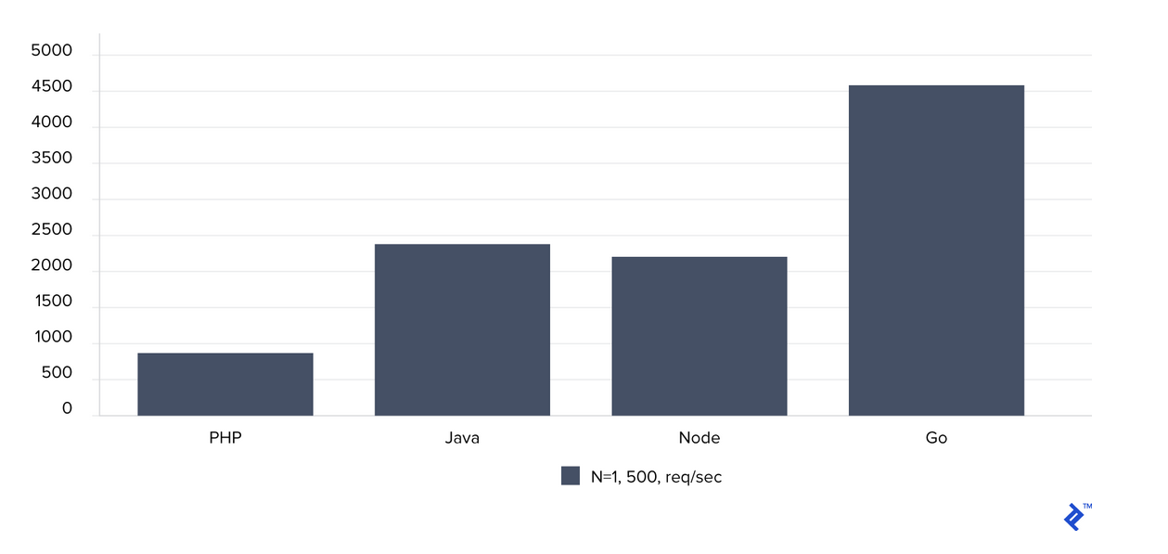
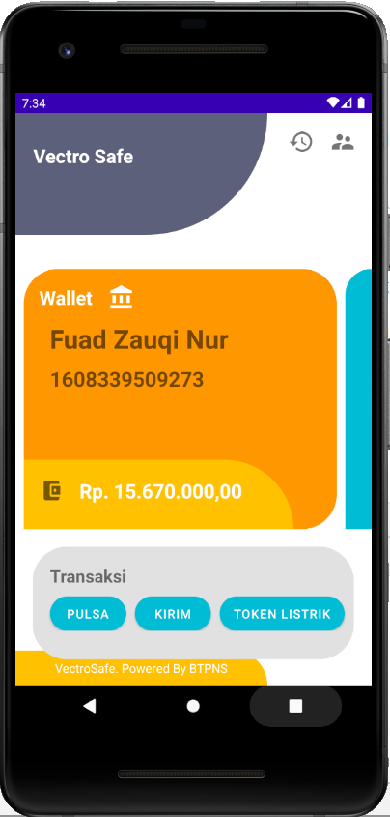
Mengapa Java?
Total number of requests per second. Higher is better.

Slide 6

Quote of the Day
Naik motor sih gas dulu aja, kalau urusan jatuh ya belakangan.
Fuad Zauqi Nur

Slide 7
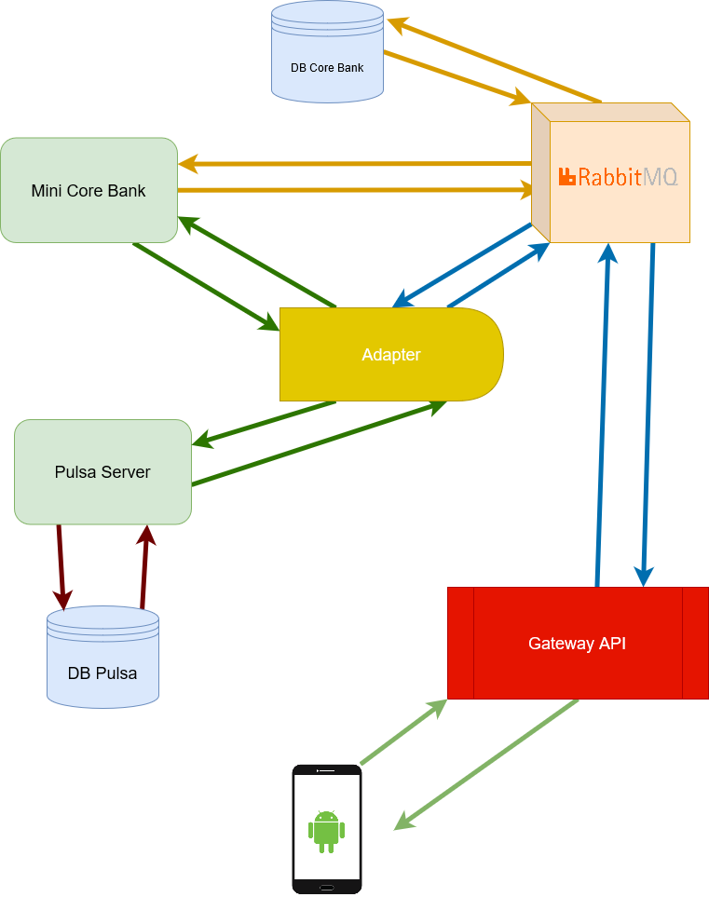
Infrastruktur API

Slide 8
Security
JJWT
JAVAX.CRYPTO
Handle on Android App

Slide 9
Checking Login Validation, if true creating jwt token
Receive Data Login
Send Login Response
Receive Login Response
Login
Send Login Data
Data Login (http)
Receive Data Login
Login Response (http)
Send Login Response
Send Data Login
Receive Login Response
Logout
Login Request
Set Shared Preferences to “”
Login Response
Shared Preferences

Slide 10
Persist Data Register if email unique
Receive Data Register
Send Register Response
Receive Reigster Response
Send Register Data
Data Register (http)
Receive Data Register
Register Response (http)
Send Register Response
Register
Send Data Register
Receive Register Response
Register Request
Register Response

Slide 11
Find Nasabah
Receive GetData
Send Nasabah Response
Receive Nasabah Response
Send GetData
Data Get (http)
Receive Data Get
Nasabah Response (http)
Send Nasabah Response
Cek Saldo
Send GetNasabah
Receive Nasabah Response
Verify JWT
GetNasabah Request
Nasabah Response

Slide 12
FindTrxList by from date to date
Receive GetDataTrx
Send TrxResponse
Receive TrxList Response
Send GetDataTrx
Data GetTrx (http)
Receive GetTrx
TrxList
Response (http)
Send Trx List Response
Mutasi
Send
GetTrx
Receive TrxList Response
Verify JWT
GetTrx Request
TrxList Response

Slide 13
Post BuyVoucher
Receive BuyVoucher
Send BuyVoucher
Response
Receive BuyVoucher Response
Send BuyVoucher
Data BuyVoucher
(http)
Receive BuyVoucher
BuyVoucher Response (http)
BuyVoucher
Response
Buy Voucher
Send Request
BuyVoucher (http)
Receive
BuyVoucher
Response
BuyVoucher
Request
Send BuyVoucher Request
Send BuyVoucher Request
BuyVoucher
Request
Verify JWT
BuyVoucher Request
BuyVoucher
Response

Slide 14
Receive Data Get
VoucherList
Response
Get Voucher List
Data Get (http)
Receive Response (http)
Send GetVoucher
Receive VoucherList Response
Send GetData
Receive VoucherList
Get Voucher
List
GetVoucher Request
VoucherList Response

Slide 15
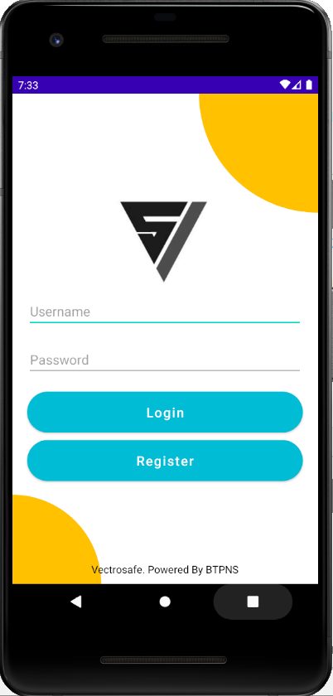
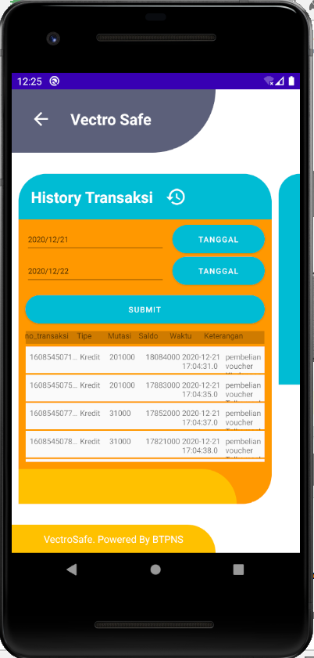
Front –End

Slide 16
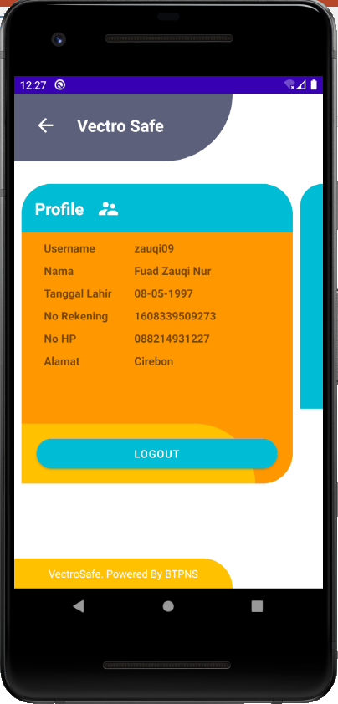
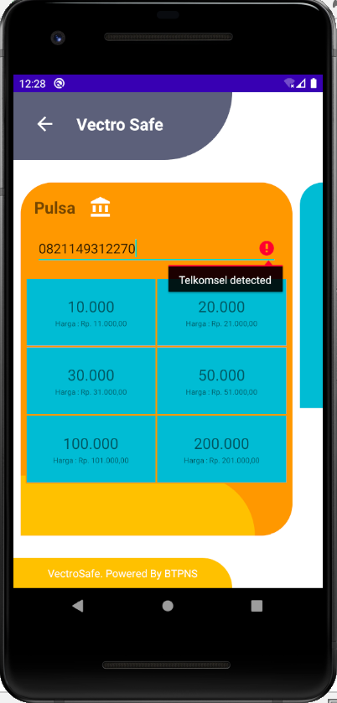
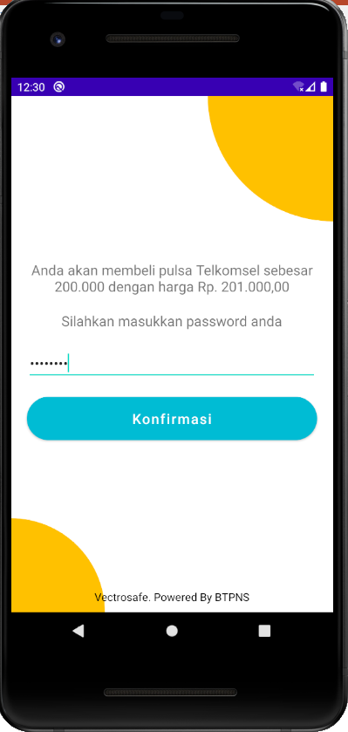
Front -End

Slide 17
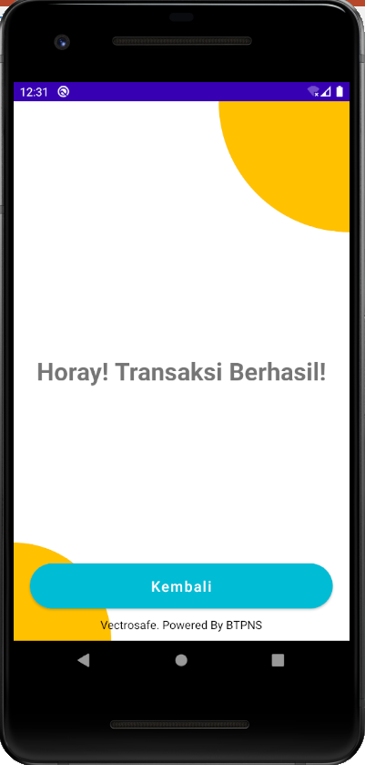
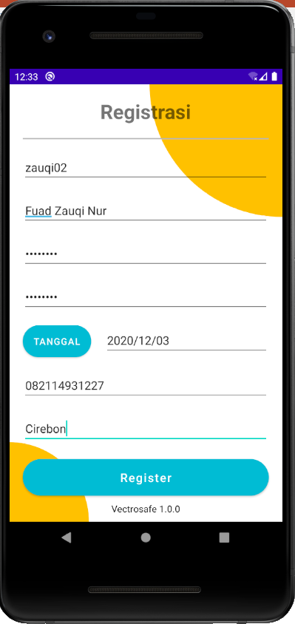
Front -End

Slide 18
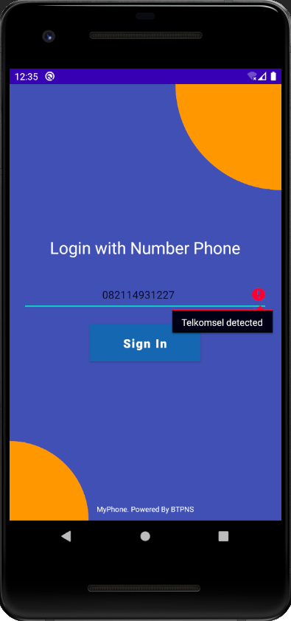
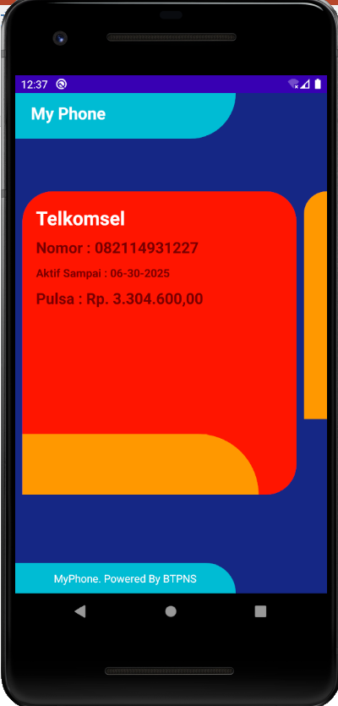
Front -End

Slide 19
Thank You

